Slide 1
Cluster Analysis
Peter Tryfos, York University

Slide 2
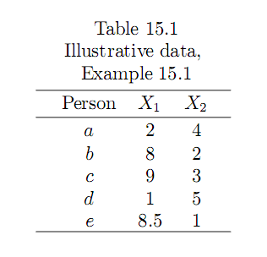
An Example of Clustering Analysis exercise
Example 15.1 The daily expenditures on food (X1) and clothing (X2) of five persons are shown in Table 15.1.

Slide 3
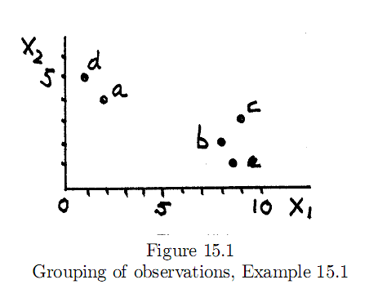
The numbers are fictitious and not at all realistic, but the example will help us explain the essential features of cluster analysis as simply as possible. The data of Table 15.1 are plotted in Figure 15.1.

Slide 4
Inspection of Figure 15.1 suggests that the five observations form two clusters.
The first consists of persons a and d, and the second of b, c and e. It can be noted that the observations in each cluster are similar to one another with respect to expenditures on food and clothing, and that the two clusters are quite distinct from each other.
These conclusions concerning the number of clusters and their membership were reached through a visual inspection of Figure 15.1.
This inspection was possible because only two variables were involved in grouping the observations. The question is: Can a procedure be devised for similarly grouping observations when there are more than two variables or attributes?

Slide 5
It may appear that a straight forward procedure is to examine all possible clusters of the available observations, and to summarize each clustering according to the degree of proximity among the cluster elements and of the separation among the clusters.
Unfortunately, this is not feasible because in most cases in practice the number of all possible clusters is very large and out of reach of current computers. Cluster analysis offers a number of methods that operate much as a person would in attempting to reach systematically a reasonable grouping of observations or variables.

Slide 6
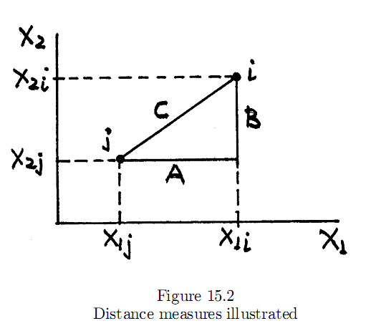
MEASURES OF DISTANCE FOR VARIABLES
Clustering methods require a more precise definition of "similarity" ("closeness", "proximity") of observations and clusters.
When the grouping is based on variables, it is natural to employ the familiar concept of distance. Consider Figure 15.2 as a map showing two points, i and j, with coordinates (X_{1i},X_{2i}) and (X_{1j} ,X_{2j}), respectively.

Slide 7
Euclidean distance
The Euclidean distance between the two points is the hypotenuse of the triangle ABC:
An observation i is declared to be closer (more similar) to j than to observation k if D(i,j) < D(i,k). An alternative measure is the squared Euclidean distance. In Figure 15.2, the squared distance between the two points i and j is

Slide 8
Euclidean distance
The distance measures can be extended to more than two variables. For example, the Euclidean distance between an observation (X_{1i},X_{2i}, . . ,X_{ki}) and another (X_{1j}, X_{2j}, . . , X_{kj}) is

Slide 9
CLUSTERING METHODS
Nearest neighbor (or single linkage) method
Furthest neighbor (or complete linkage) method
Average linkage method
K-means method

Slide 10
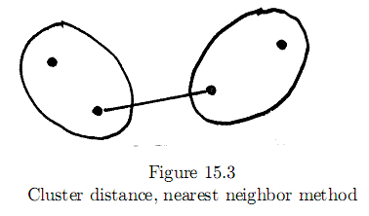
Nearest Neighbor Method
One of the the simplest method to treat the distance between the two nearest observations, one from each cluster, as the distance between the two clusters. This is known as the nearest neighbor (or single linkage) method. Figure 15.3 illustrates.

Slide 11
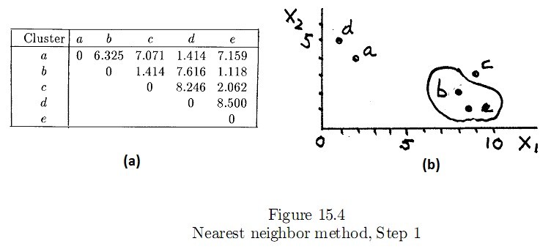
Nearest Neighbor Method
Example 15.1 (Continued) Let us suppose that Euclidean distance is the appropriate measure of proximity. We begin with each of the five observations forming its own cluster. The distance between each pair of observations is shown in Figure 15.4(a).

Slide 12
Nearest Neighbor Method
For example, the distance between a and b is
Observations b and e are nearest (most similar) and, as shown in Figure 15.4(b), are grouped in the same cluster.
Assuming the nearest neighbor method is used, the distance between the cluster (be) and another observation is the smaller of the distances between that observation, on the one hand, and b and e, on the other. For example,

Slide 13
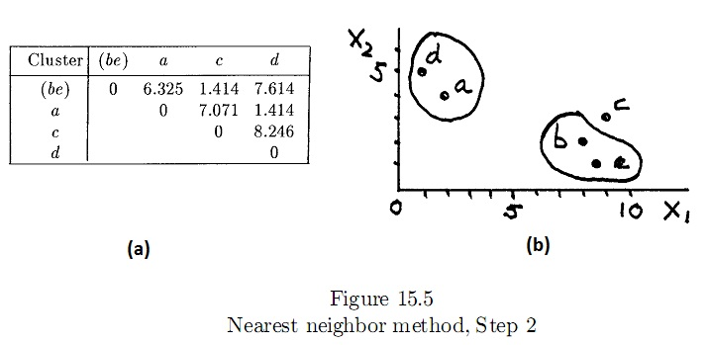
Nearest Neighbor Method
The four clusters remaining at the end of this step and the distances between these clusters are shown in Figure 15.5(a).

Slide 14
Nearest Neighbor Method
Two pairs of clusters are closest to one another at distance 1.414; these are (ad) and (bce). We arbitrarily select (a,d) as the new cluster, as shown in Figure 15.5(b). The distance between (be) and (ad) is
while that between c and (ad) is

Slide 15
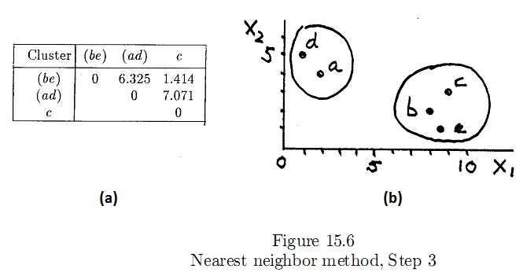
Nearest Neighbor Method
The three clusters remaining at this step and the distances between these clusters are shown in Figure 15.6(a). We merge (be) with c to form the cluster (bce) shown in Figure 15.6(b). The distance between the two remaining clusters is

Slide 16
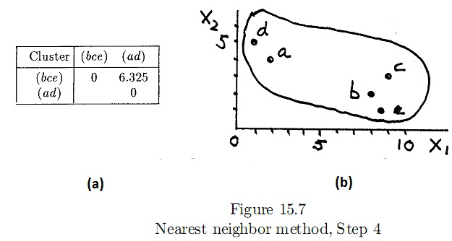
Nearest Neighbor Method
The grouping of these two clusters, it will be noted, occurs at a distance of 6.325, a much greater distance than that at which the earlier groupings took place. Figure 15.7 shows the final grouping.

Slide 17
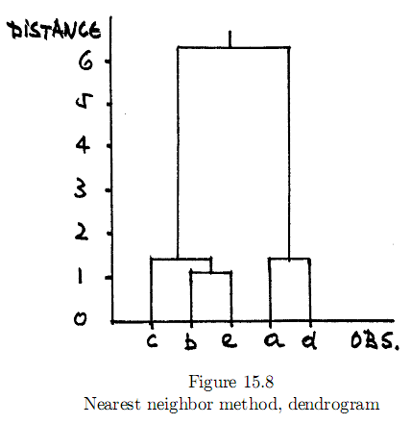
Nearest Neighbor Method
The groupings and the distance at which these took place are also shown in the tree diagram (dendrogram) of Figure 15.8.

Slide 18
Nearest Neighbor Method
One usually searches the dendrogram for large jumps in the grouping distance as guidance in arriving at the number of groups.
In this illustration, it is clear that the elements in each of the clusters (ad) and (bce) are close (they were merged at a small distance), but the clusters are distant (the distance at which they merge is large).

Slide 19
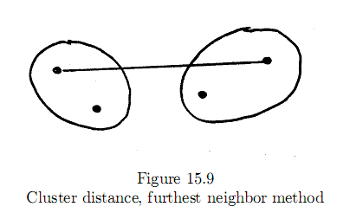
Furthest Neighbor Method
Under the furthest neighbor (or complete linkage) method, the distance between two clusters is the distant members. Figure 15.9 illustrates.

Slide 20

Furthest Neighbor Method
Example 15.1 (Continued) The distances between all pairs of observations shown in Figure 15.4 are the same as with the nearest neighbor method. Therefore, the furthest neighbor method also calls for grouping b and e at Step 1. However, the distances between (be), on the one hand, and the clusters (a), (c), and (d), on the other, are different:

Slide 21
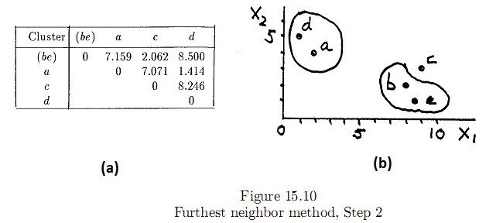
Furthest Neighbor Method
The four clusters remaining at Step 2 and the distances between these clusters are shown in Figure 15.10(a).
The nearest clusters are (a) and (d), which are now grouped into the cluster (ad). The remaining steps are similarly executed.

Slide 22
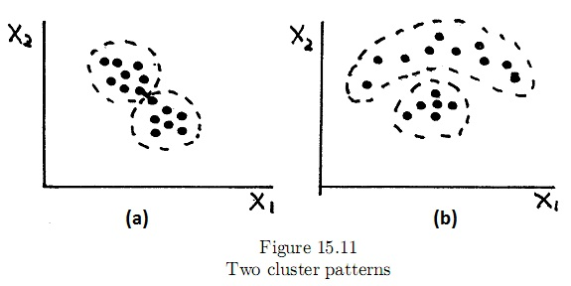
Average Linkage Method
In other cases, however, the two methods : nearest and furthest neighbor methods does not produce the same result.
Consider Figure 15.11(a) as an example :

Slide 23
Average Linkage Method
The nearest neighbor method will probably not form the two groups percived by the naked eye. This is so because at some intermediate step the method will probably merge the two " nose" points joined in Figure 15.11(a) into the same cluster, and proceed to string along the remaining points in chain-link fashion.
The furthest neighbor method, will probably identify the two clusters because it tends to resist merging clusters the elements of which vary substantially in distance from those of the other cluster.
On the other hand, the nearest neighbor method will probably succeed in forming the two groups marked in Figure 15.11(b), but the furthest neighbor method will probably not.

Slide 24
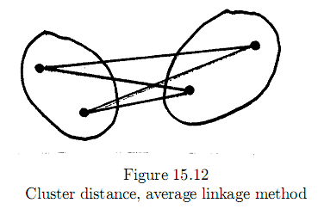
Average Linkage Method
A compromise method is average linkage, under which the distance between two clusters is the average of the distances of all pairs of observations, one observation in the pair taken from the first cluster and the other from the second cluster as shown in Figure 15.12.

Slide 25
Average Linkage Method
Figure 15.13 shows the slightly edited output of program SPSS, instructed to apply the average linkage method to the data of Table 15.1.
In Problem 15.2 (average linkage method on example 15.1), we let the reader confirm these results and compare them to those of earlier methods. The three methods examined so far are examples of hierarchical agglomerative clustering methods.
"Hierarchical" because all clusters formed by these methods consist of mergers of previously formed clusters. “Agglomerative" because the methods begin with as many clusters as there are observations and end with a single cluster containing all observations.

Slide 26
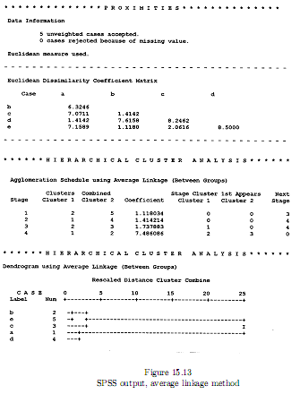

Slide 27
K-means Method
There are many other clustering methods. For example, a hierarchical divisive method follows the reverse procedure in that it begins with a single cluster consisting of all observations, forms next 2, 3, etc. clusters, and ends with as many clusters as there are observations.
It is not our intention to examine all clustering methods. We do want to describe, however, an example of non-hierarchical clustering method, the so-called k-means method.

Slide 28
K-means Method
In its simplest form, the k-means method follows the following steps :
  Step 1 : Specify the number of clusters and, arbitrarily or deliberately (=with intention), the members of each cluster.
  Step 2 : Calculate each cluster's "centroid" (explained below), and the distances between each observation and centroid. If an observation is nearer the centroid of a cluster other than the one to which it currently belongs, re-assign it to the nearer cluster.
  Step 3 : Repeat Step 2 until all observations are nearest the centroid of the cluster to which they belong.
  Step 4 : If the number of clusters cannot be specified with confidence in advance, repeat Steps 1 to 3 with a different number of clusters and evaluate the results.

Slide 29
K-means Method
Example 15.1 (Continued) Suppose two clusters are to be formed for the observations listed in Table 15.1.

Slide 30
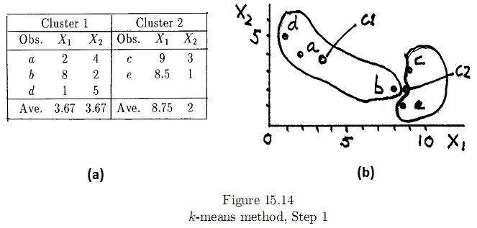
K-means Method
We begin by arbitrarily assigning a, b and d to Cluster 1, and c and e to Cluster 2. The cluster centroids are calculated as shown in Figure 15.14(a).

Slide 31
K-means Method
The cluster centroid is the point with coordinates equal to the average values of the variables for the observations in that cluster. Thus, the centroid of Cluster 1 is the point (X1 = 3.67, X2 = 3.67), and that of Cluster 2 the point (8.75, 2). The two centroids are marked by C1 and C2 in Figure 15.14(a).
The cluster's centroid, therefore, can be considered the center of the observations in the cluster, as shown in Figure 15.14(b).

Slide 32


K-means Method
We now calculate the distance between a and the two centroids:
Observe that a is closer to the centroid of Cluster 1, to which it is currently assigned. Therefore, a is not reassigned.
Next, we calculate the distance between b and the two cluster centroids:

Slide 33
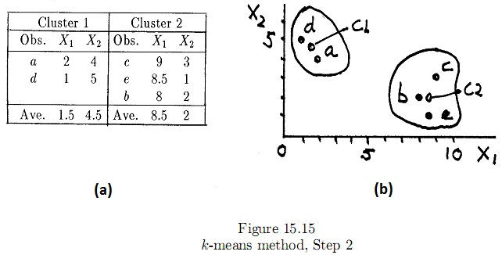
K-means Method
Since b is closer to Cluster 2's centroid than to that of Cluster 1, it is reassigned to Cluster 2. The new cluster centroids are calculated as shown in Figure 15.15(a).

Slide 34
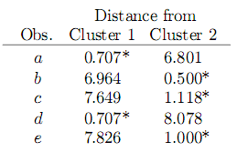
K-means Method
The new centroids are plotted in Figure 15.15(b). The distances of the observations from the new cluster centroids are as follows (an asterisk indicates the nearest centroid):
Every observation belongs to the cluster to the centroid of which it is nearest, and the k-means method stops. The elements of the two clusters are shown in Figure 15.15(b).

Slide 35
K-means Method
Other variants of the k-means method require that the first cluster centroids (the "seeds", as they are sometimes called) be specified.
These seeds could be observations. Observations within a specified distance from a centroid are then included in the cluster. In some variants, the first observation found to be nearer another cluster centroid is immediately reassigned and the new centroids recalculated, in others reassignment and recalculation await until all observations are examined and one observation is selected on the basis of certain criteria.
The " quick" or " fast" clustering procedures used by computer programs such as SAS or SPSS make use of variants of the k-means method.

Slide 36
Reference
Tryfos, Peter . Cluster Analysis. York University,2001.

